Slide 1

Urba Ali Awan
Student of CIT
Week 5

Slide 2
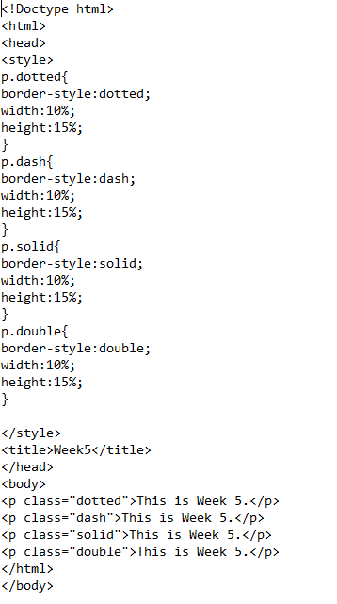
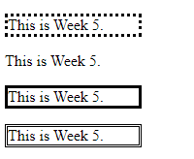
Border-Style
Example:
Output
p. dotted{
border-style: dotted;
}
The border-style property sets the style of an element's four borders. This property can have from one to four values.
border-types:
dotted
dash
solid
double

Slide 3
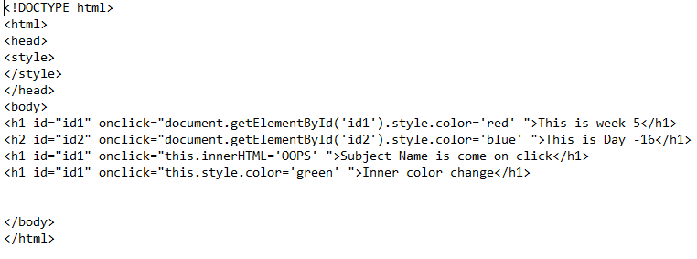
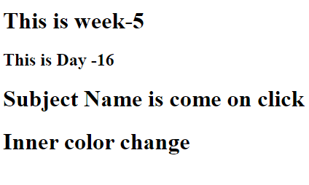
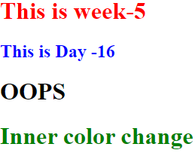
On-click
Example:
text
The onclick attribute is an event attribute that is supported by all browsers. It appears when the user clicks on a button element.
Output

Slide 4

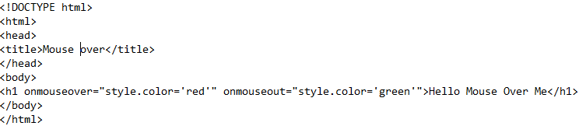


Mouse-cursor
The cursor property sets or returns the type of cursor to display for the mouse pointer.
Example: Output

Slide 5
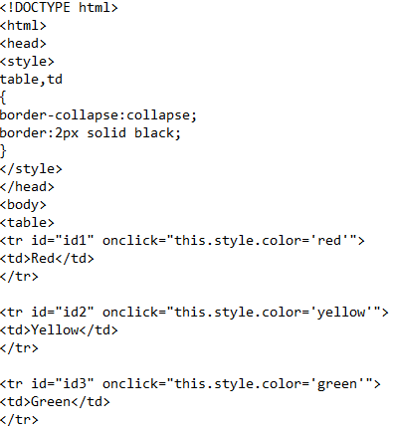
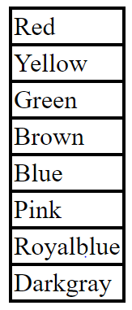
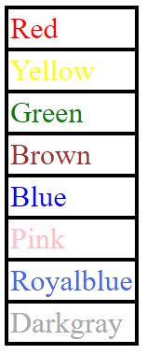
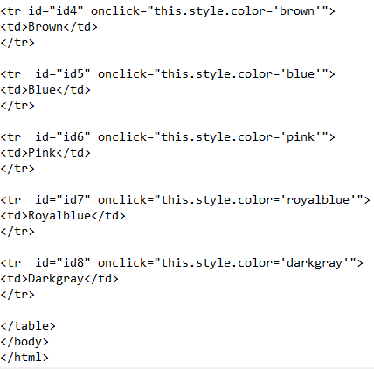
Table-color On-click
The tablecolor onclick event occurs when the user clicks on an element.
Example:
Output

Slide 6
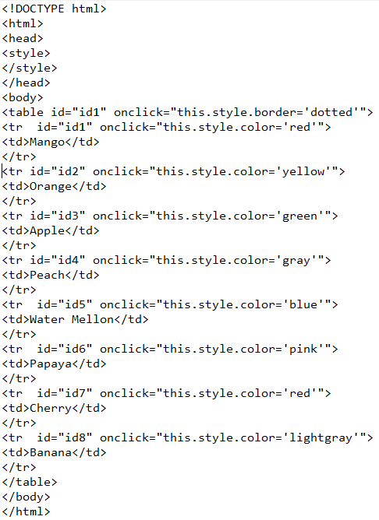
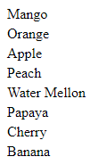
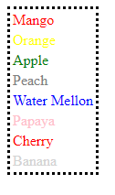
On-click-table-dash
Example:
Output
The onclick tabledash event occurs when the user clicks on an element.

Slide 7
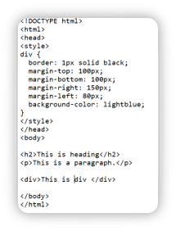
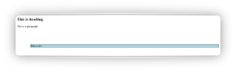
Margin
Example:
<margin>----</margin>
Why we use margin tag in html?
HTML margin-left sets the margin area on the left side of an element.
CSS has properties for specifying the margin for each side of an element:
margin-top:
margin-bottom:
margin-right:
margin-left:
Output

Slide 8
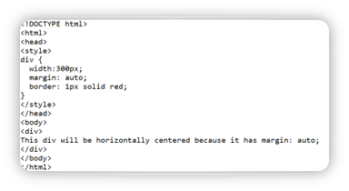

Div
Example:
<div>------</div>​
Why we use div tag in html?​
The div tag is used in HTML to make divisions of content in the web page like (text, images, header, footer, navigation bar, etc). ​
Output​

Slide 9
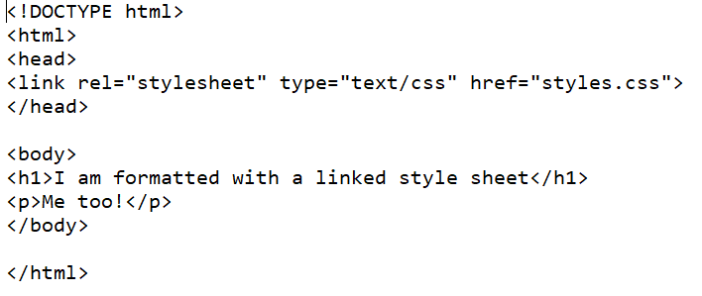
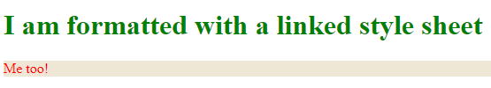
LINK
Example:
<link>-----</link>
Why we use link tag in html?
The <link> tag defines a link between a document and an external resource.
The <link> tag is used to link to external style sheets.
Output​

Slide 10
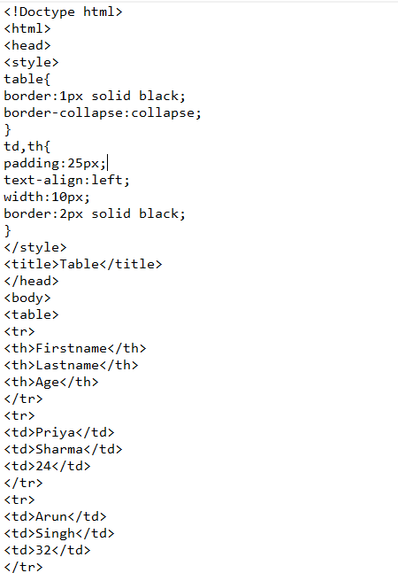
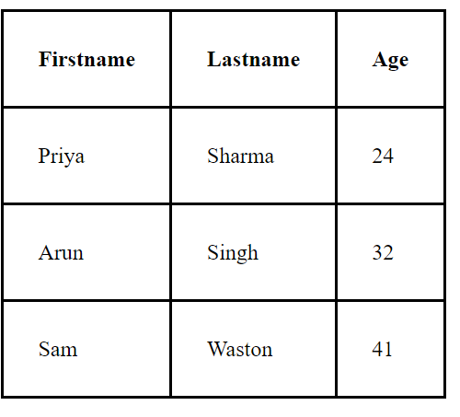
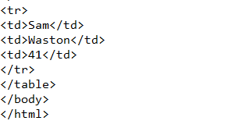
Table
Example:
Output
<table>-----</table>​
Why we use table tag in html?​
The <table> tag defines an HTML table.​
An HTML table consists of the <table> element and one or more <tr>, <th>, and <td> elements.​
The <tr> element defines a table row, the <th> element defines a table header, and the <td> element defines a table cell.​

Slide 11
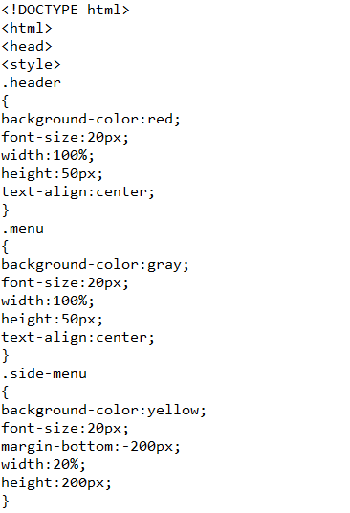
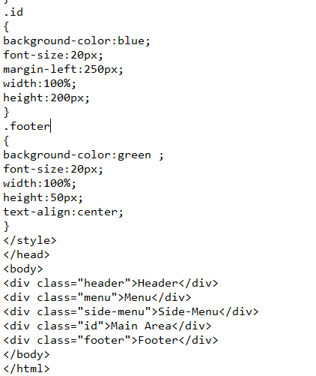
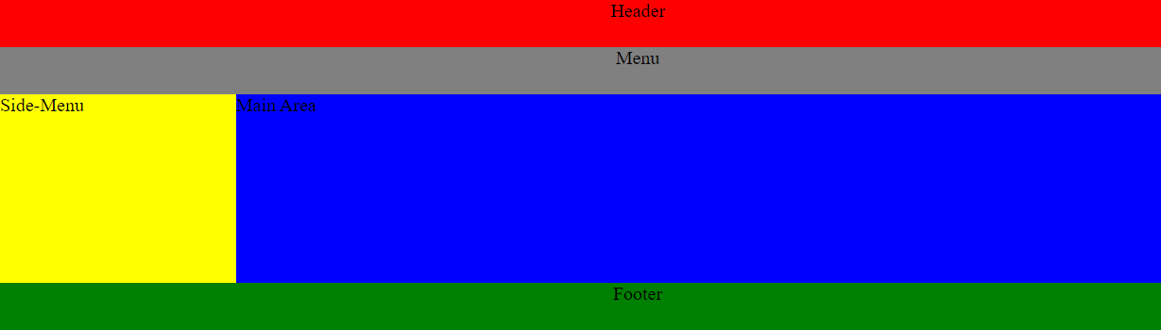
Example:
Header-Menu-Mainarea-Sidemeanu-Footer
The <header> tag in HTML is used to define the header for a document or a section.
The <menu> tag defines a list/menu of commands.
The <main> tag specifies the main content of a document.
The side menu contains information related to the inmain story. The side menu always appears on the left side of the page.
The <footer> tag in HTML defines a footer for a document or a section of a web page. Footers usually contain the author of a document, contact information, and important links. A footer at the bottom of a section will include any final information related to the content in that section.
Output

Slide 12

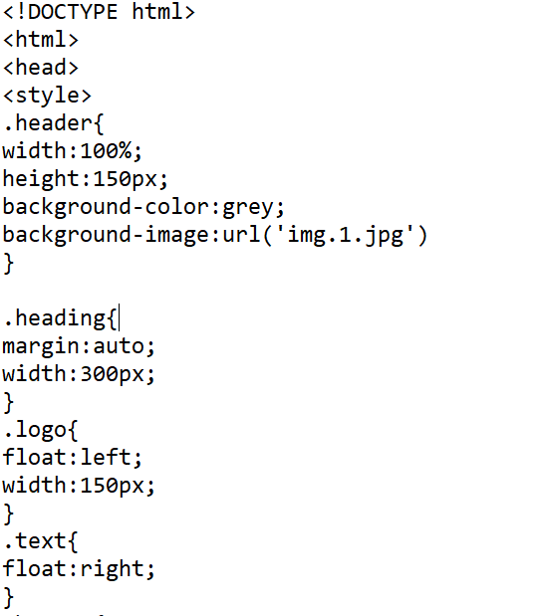
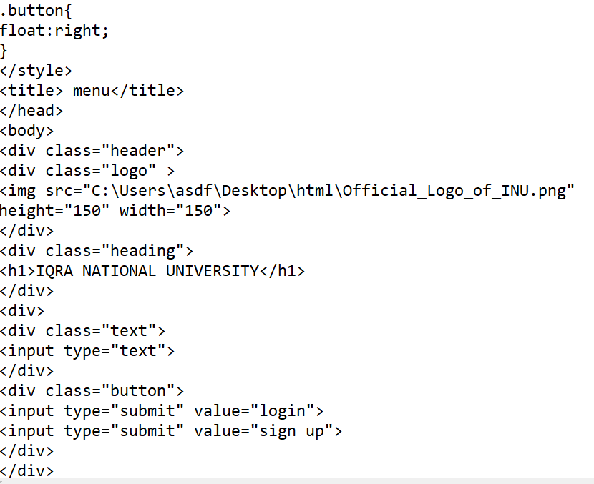

Float
Example:
The float property specifies whether an element should float to the left, right, or not at all.
Output

Slide 13

Thank You!

